Slide 1
Correlation analysis
Natalia Levshina
Jena, WiSe 2017

Slide 2
Outline
1. Word length and reaction times
- Visualization of correlation
- Pearson’s correlation coefficient r
2. Acquisition of grammar and lexicon in L1
- Visualization of correlation
- Spearman’s rho
- Kendall’s tau
3. Correlation and causation

Slide 3
Word length and reaction times
Hypothesis: there is some correlation between word length and mean reaction times in a lexical decision task.
This is a non-directional alternative hypothesis.
Null hypothesis: no correlation.

Slide 4
Scatter plot
> attach(ldt)
> plot(Length, Mean_RT)

Slide 5
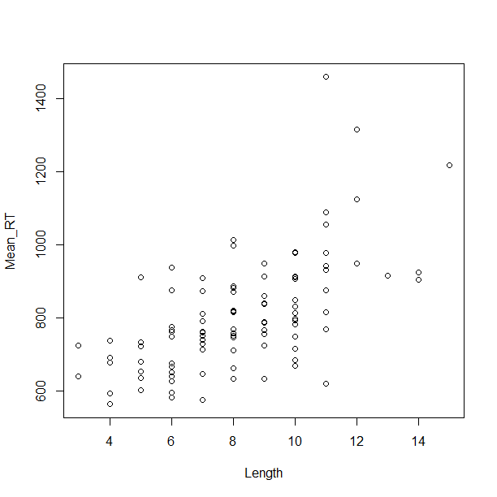

Slide 6
Correlation
Is a relationship between two numeric variables
Positive: as X increases, Y increases, too. E.g. the more beers you drink before a psycholinguistic experiment, the longer your reaction times will be.
Negative, or inverse: as X increases, Y decreases. E.g. the more frequent a word, the shorter it is (Zipf’s Law of Abbreviation).

Slide 7
Correlation coefficient
A statistic from -1 to 1 which shows the direction and strength of a correlation.
Negative correlation: from -1 to 0
Positive correlation: from 0 to 1
No correlation: 0

Slide 8
Perfect positive and negative correlations

Slide 9
Strong, weak and zero correlation

Slide 10
Exercise
Can you think of one example of a positive correlation, one example of a negative correlation, and one example of no correlation between two variables?

Slide 11
Types of relationships
Monotonic linear
Use Pearson’s r
Monotonic non-linear
Use Spearman’s rho or Kendall’s tau
Non-monotonic
A more sophisticated method is needed

Slide 15
Question: what kind of relationship?

Slide 16
Pearson’s r with all data
> cor.test(Length, Mean_RT) #by default, Pearson and two-tailed
Pearson's product-moment correlation
data: Length and Mean_RT
t = 7.7158, df = 98, p-value = 1.019e-11
alternative hypothesis: true correlation is not equal to 0
95 percent confidence interval:
0.4757761 0.7237704
sample estimates:
cor
0.6147456

Slide 17
Beware of outliers
Can distort the results:

Slide 18
Remove 3 old suspects
> Mean_RT_new <- Mean_RT[Mean_RT < 1200]
We also need to remove them from Length, so that the vectors are equally long:
> Length_new <- Length[Mean_RT < 1200]

Slide 19
Pearson’s r without outliers
> cor.test(Length_new, Mean_RT_new)
Pearson's product-moment correlation
data: Length_new and Mean_RT_new
t = 7.0965, df = 95, p-value = 2.289e-10
alternative hypothesis: true correlation is not equal to 0
95 percent confidence interval:
0.4409167 0.7052541
sample estimates:
cor
0.5886011

Slide 20
Interim conclusions
The null hypothesis of no association can be rejected.
The correlation is positive and significant.

Slide 21
Outline
1. Word length and reaction times
- Visualization of correlation
- Pearson’s correlation coefficient r
2. Acquisition of grammar and lexicon in L1
- Visualization of correlation
- Spearman’s rho
- Kendall’s tau
3. Correlation and causation

Slide 22
Acquisition of grammar and lexicon
Bates and Goodman (1997) investigated the relationships between vocabulary size and grammatical development of young children during the period from 16 to 30 months.
Hypothesis: there is a positive correlation between vocabulary size and grammatical development.
Vocabulary size: the number of words learnt
Grammar: the total number of target constructions, from 0 to 37

Slide 23
Creating the data and a scatter plot
> lex <- c(47, 89, 131, 186, 245, 284, 362, 444, 553, 627)
> gram <- c(0, 2, 1, 3, 5, 9, 7, 16, 25, 34)
> plot(lex, gram)

Slide 24
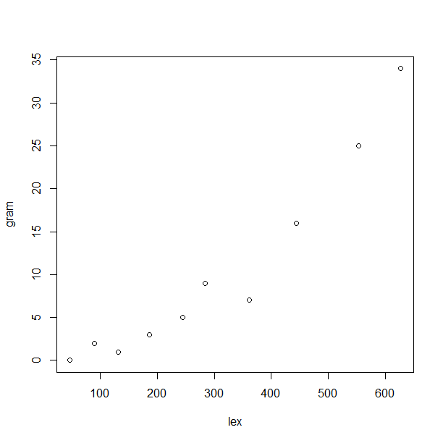

Slide 25
Spearman’s rho
> cor.test(lex, gram, method = "spearman“, alternative = "greater") #one-tailed
Spearman's rank correlation rho
data: lex and gram
S = 4, p-value < 2.2e-16
alternative hypothesis: true rho is greater than 0
sample estimates:
rho
0.9757576

Slide 26
Kendall’s tau
> cor.test(lex, gram, method = "kendall", alternative = "greater")
Kendall's rank correlation tau
data: lex and gram
T = 43, p-value = 1.488e-05
alternative hypothesis: true tau is greater than 0
sample estimates:
tau
0.9111111

Slide 27
Interim conclusion
The null hypothesis of no correlation can be safely rejected.
There is a significant positive and very strong correlation between vocabulary size and grammatical development.

Slide 28
Outline
1. Word length and reaction times
- Visualization of correlation
- Pearson’s correlation coefficient r
2. Acquisition of grammar and lexicon in L1
- Visualization of correlation
- Spearman’s rho
- Kendall’s tau
3. Correlation and causation

Slide 29
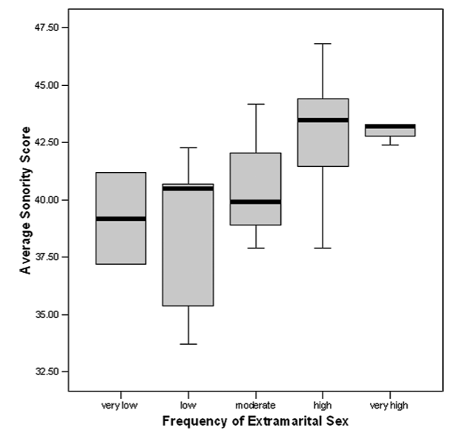
Correlation is NOT causation
From Ember & Ember 2007

Slide 30

Spurious correlations
http://www.tylervigen.com/spurious-correlations
Theory of the Stork: a positive correlation between the number of storks and that of newborns -> do storks bring babies?!

Slide 31
Exercise
Everett (2013) reported a positive correlation between elevation and the likelihood that a language contains ejective consonants:
“We suggest that ejective sounds might be facilitated at higher elevations due to the associated decrease in ambient air pressure, which reduces the physiological effort required for the compression of air in the pharyngeal cavity–a unique articulatory component of ejective sounds. In addition, we hypothesize that ejective sounds may help to mitigate rates of water vapor loss through exhaled air. ”
Can you think of another way of explaining this correlation?
http://journals.plos.org/plosone/article?id=10.1371/journal.pone.0065275

